Slide 1
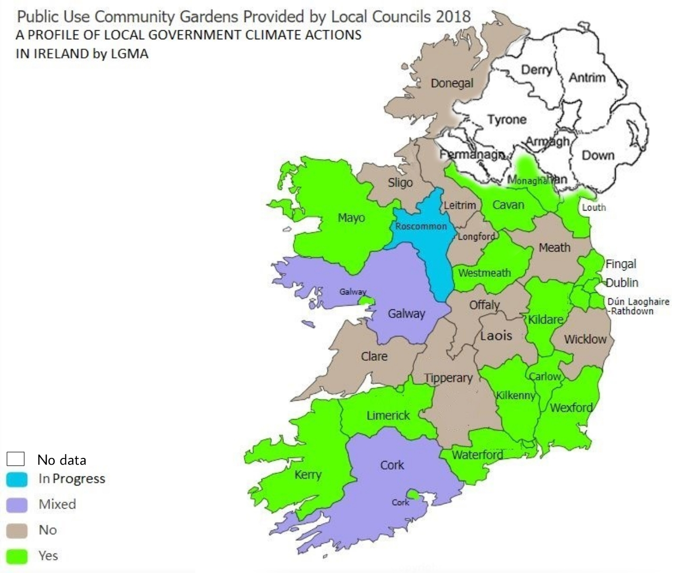
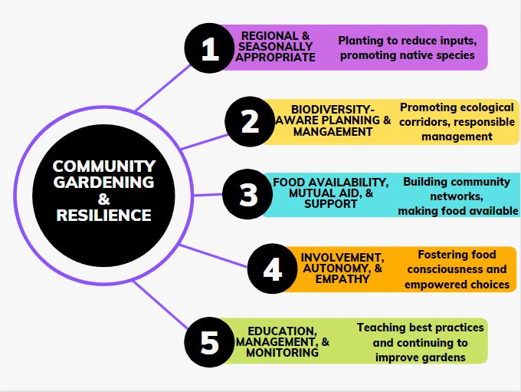
Agri-food Resilience Through Community Resilience?
Community Garden Impacts on Social Transformation and Biodiversity
K. S. Everette¹, Peter C. McKeown¹, & Charles Spillane¹
¹MSc CCAFS Program, Plant & AgriBiosciences Research Centre (PABC), Ryan Institute, National University of Ireland Galway
Research challenge
Community food production is an underutilized within the current agri-food system, particularly community gardening. This project utilizes current data from community garden surveys within Ireland and the United Kingdom to inform scalability through mapping of the current scope of community gardens in Ireland and the United Kingdom, review of novel quantification tools, as well as financing.
Student Bio
Kayti Everette received a B.A. degree in Latin American Studies from Knox College, IL, USA, as well as an M.A. in Culture and Colonialism from NUIG, IE, and is now completing the MSc CCAFS at NUIG. Professional interests are varied and pertain to the intersections of nature and community, habitat restoration, community land trusts, disease ecology, and conservation. Previous work experience in USA, Ireland, and Perú, with keen interest in pursuing a career related to the above areas. E-mail: kseverette@knox.edu
Methodology
Results
This review found
that there are
multiple ways to potentially scale community gardening nationally through various government financing schemes, as well as the potential for novel quantification of community gardens through a social cost-benefit analysis strategy. It is difficult to determine CG impacts on biodiversity and environmental impacts due to lack of data, but careful management of garden spaces, particularly non-native species is recommended.
The research methodology approach taken by this research was based on a review of various databases (Academic Search Complete, JSTOR) and Google Scholar, review of local governmental policies within Ireland (Department of Rural and Community Development, Department of the Environment, Climate and Communications, Department of Agriculture, Food and the Marine), as well as publicly available data for map-making. Survey data from CGI’s 2021 National Survey was also utilized.
Figure 2: Map depicting councils which provided community gardens in 2018 based on data from LGMA survey (Keane, 2021).
Context/study area
Community Gardening refers to the tending of a shared plot of land where members have autonomy over the cultivation, harvest, distribution, and maintenance of the space. There are numerous social benefits associated with the practice, but more research is needed on the food security benefits and potential for scaling for agri-food resilience.
Conclusions
Future work should address the knowledge gaps identified, including the need for data collection surrounding community gardening, including surveying the crops grown, inputs used, harvest yield size, labor hours, and garden plot size, in order to inform potentials for upscaling community gardens for agri-food resilience.
Figure 1: The graphic shows five thematic areas that are tied to community gardening and resilience. (Everette, 2022)
Key References: CGI. (2021). Community Gardens Ireland National Survey. Community Gardens Ireland. Retrieved August 7, 2022, from http://cgireland.org/community-gardens-ireland-survey/; Keane, R. (2021). Allotments and community gardens by local authority. IRELAND'S OPEN DATA PORTAL. Retrieved August 9, 2022, from https://data.gov.ie/dataset/allotments-and-community-gardens-by-local-authority?nocache=true; Schoen, V., Caputo, S., & Blythe, C. (2020). Valuing physical and social output: A rapid assessment of a London community garden. Sustainability, 12(13), 5452. https://doi.org/10.3390/su12135452
https://www.plantagbiosciences.org/people/katherine-everette/

