Slide 1
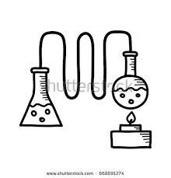
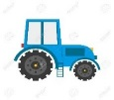
WATER (borehole) dillution
N.B: Protein content will differ between CRAL, CRPL, CINT. Maybe consider a nutrient index
Protein feed production
e.g. soybean meal
Grains
YEAST and enzymes
water
Botanicals foraged (sugar kelp, sand-dune berries)
Bottles production and transport to distillery
Packaging (cork, plastic cover, labels, carton)
Compost (1/year)
NPK application
Agro-chemicals
Diesel - field operations (soil tillage, harrowing, sowing, harvesting)
Treatment 1 (boiling grains)
Blueberry and Juniper ( produced on estate)
FEEDMILL
Energy (electrical, thermal, fossil fuel)
Milled and Mached
NH₃, N₂O
Drying process (if applicable)
Winter Wheat (crop rotation without legume)
Peas (crop rotation legume)
Boiling
neutral spirit fermentation and distillation (3 distillations)
Refrigeration
Gin distillation (2-3 distillations)
Distiller grain/Nutrients extractions
P & N leaching
GRAINS
DISTILLERY SYSTEM
Other ingredients (cereals, fishmeal, soy, poultry)
Harvest
Aging in cask?
Agriculturefeed production
Electricity/heat
Co products bio-residuals
Bottling
water
DDGS
Fugitive emission (from refrigeration)
Yeast
Waste Water (spent lees)
Solid Waste
Packaging
lubricant
FARM SYSTEM
Allocate off
Wastewater treatment
Landfills/Compost/Biorefinery/inceniration
Process flow By products Potential re-use and substitution
Emissions (vapour, GHGs etc)
Transport
Leaching (this should be emphasised in agricultural system susceptible to high precipitation such as Scotland)
Energy (heat/electricity etc)
Distribution
Inputs and actions
outputs
Agricultural and aquaculture feed

