Slide 1
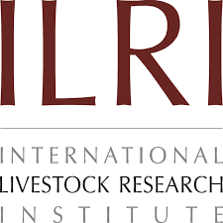
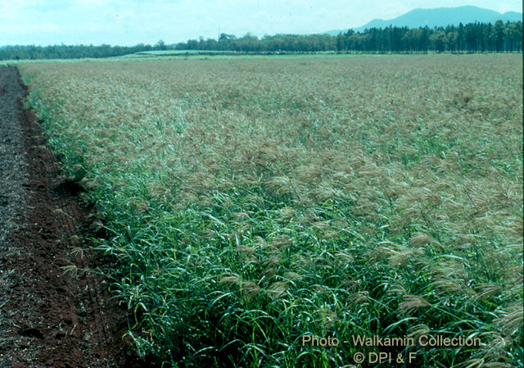
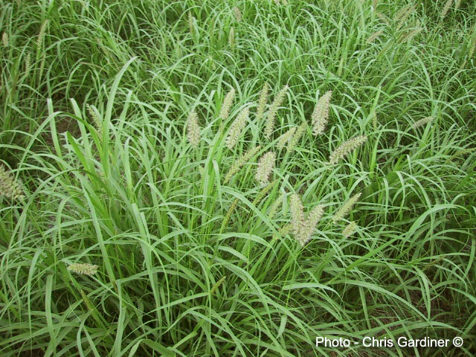
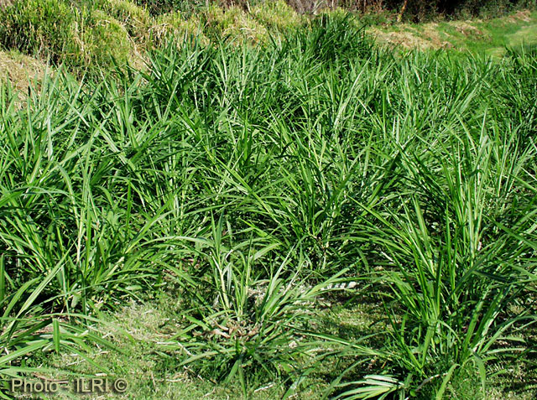
A
Potential impact of three forage grass species in livestock systems under climate change
Kelebogile Kekae¹, Peter C. McKeown¹, Galina Brychkova¹, Charles Spillane¹,
Chris S. Jones², Phil Thornton³ and Jean Hanson².
¹MScCCAFS Program, Plant & AgriBiosciences Research Centre (PABC), National University of Ireland Galway, University Road, Galway H91 REW4, Ireland; ²International Livestock Research Institute, PO Box 5689, Addis Ababa, Ethiopia; ³CCAFS/International Livestock Research Institute, PO Box 30709, Nairobi 00100, Kenya.
A
Climate change, forages and livestock
Climate change can significantly influence forage production and quality. Forages form the basis part of animal nutrition and economic benefit in livestock systems; the influence of climate change on forages may ultimately impact animal nutrition and economic benefits within livestock systems While promising forage accessions of forage species have been identified, little research has been conducted on determining their potential under climate change. There is a need to identify forage accessions and species that can stand climate change impacts and reduce risks on livestock systems.
MScCCAFS student Bio
Kelebogile Kekae holds a BSc degree in Animal Science from Northwest University, South Africa, and is currently completing the MScCCAFS degree at NUI Galway. Professional interests include Sustainable agricultural systems, and Livestock nutrition. E-mail: Kekae.Kelebogile@gmail.com
Forages in Ethiopian dairy systems
The 3 forage species are distinct on their environmental adaptation and use, and may be that as the climate change, there may be options to change between them.
Research challenge
Forage grasses can form part of adaptation strategies to climate change. However, it is necessary to identify what forage accessions can be grown under future climate scenarios in different regions (Molden, 2007). Additionally, there is a need to address trade-offs which may disadvantage forage productivity in livestock systems.
A
B
C
B
C
Figure 1: (A) Rhodes, (B) Buffel and (C) Napier grass. Source: Tropical Forages - (A) Walkamin collection, (B) Chris Gardiner, (C) ILRI
Building on ILRI’s results to date
Previous ILRI studies have focused on the environmental adaptation of the three different forage grass species, particularly characterization of their accessions on agronomic, physiological and morphological traits. All three forage species have potential for African agriculture, with some drought tolerance potential.
Research Objectives
To determine the current use and hectares planted compared with the potential area based on current climate and livestock systems.
To investigate tradeoffs by modelling profitability of forages and crops
To model the effect of climate change on potential area grown and profitability
To estimate the potential impact of identifying more drought tolerant lines.
The research will use climate tools and GIS on ILRI datasets of 2 research sites in Ethiopia.
Key References:
Molden (2007) Earthscan; George et al (2008) Tropical Grasslands 42:27-39; Mark et al (1999) Tropical Grasslands 33:150-158; Posens et al (2010) Field Crops Research 118:57-72
Acknowledgements: This MScCCAFS project acknowledges funding and
resource support from Irish Aid and International Livestock Research Institute
www.plantagbiosciences.org/mscccafs-students

